Slide 1

Business name Impact Planning Workshop Date

Slide 2

Proposed Agenda
Attendees should include a mixture of senior leaders and other socially influential employees (Talents) within the Division/Business Unit, ensuring there is both a representation of Business and HR.
TIME | AGENDA ITEM | RESOURCES | RESPONSIBLE
2 Min | Welcome and outline objective of the workshop |  | President/ MD
10 Min | Sharing of key results, highlighting the key concern areas coming forward. |  | HR
10 Min | Discussion and voting, on the top 4 areas to focus on for 2022 | Flip chart & Markers | HR/Business
 | Split the team into 4 groups, to each focus on one of the identified areas
20 Min | Each group – Empathy Map | 4 Blank Empathy map posters + Post its | HR
15 Min | Debrief on Empathy Map findings |  | HR/ Business
15 Min | You may ask participants to move around to another group if they wish. 5 Whys | Flip chart per team | HR
15 Min | Debrief on 5 Whys findings |  | HR/ Business
10 Min | BREAK
30 Min | Set up tables and place the last findings for each group on a separate table – World café 3 rounds | 4 tables set up with flip chart paper/ paper table cloth and markers | HR
10 Min | Debrief on World Café findings |  | HR/Business
15 Min | Align on plan and assign responsible persons per action | Flip Chart | HR
Set 3.5 Hours

Slide 3


Context Setting | Employee Engagement Survey 2022
SURVEY PERIOD
SURVEY DESIGN
RESPONSE RATE
SENTIMENTS
CONFIDENTALITY
Survey was conducted from
1 Nov 2022 – 23 Nov 2022
Consisted of 34 statements and 1 open-ended question
Invited: 1,108
Responded: 1,031
89% Response Rate
Survey responses were gathered using a 5-point scale
1: Strongly Disagree
2: Disagree 3: Neither Agree nor Disagree
4: Agree
5: Strongly Agree
To ensure confidentiality and appropriate interpretation, scores are calculated only for 4 or more respondents
Scores of respondents below 4 are not visible however they are rolled up to contribute to the overall score
All respondents are kept confidential, and anonymity is guaranteed

Slide 4



Executive Summary
xxxxxx FAVORABILITY SCORE IN COMPARISON TO THE LAST YEAR
01
Overall favorability scores for xxxx across Automotive Division have no impact from the last year.
FY 2022 Overall Result-xxx
FY 2021 Overall Result- xxx
HIGHEST & LOWEST SCORING STATEMENTS
Highest:
Clearly defined goalsxxx
Clear link between my work and company objectives xxx
What is important to our customers when making decisions…… ( 93 %),
Lowest:
Supervisor takes an interest in my growth and developmentxxx
Actions from the last surveyxxxx
Accomplishments are recognisedxxx
02
03
FAVORABILITY SCORES FOR ALL DIMENSIONS
Favorability scores from 3 dimensions have increased as compared to 2021
Favorability scores for both Male and Female has improved across all Dimensions
Xxxx have had an overall stay same in favorability scores as 2021
Opportunity to xxxxx
Opportunity to xxxxx
Opportunity to xxxxx

Slide 5
Most & Least Favorable –
Top 3 Most Favorable
Bottom 3 Most Unfavorable

Slide 6
Top 10 Most Favorable

Slide 7
Bottom 10 Most Unfavorable

Slide 8
Heat map

Slide 9
Xxxxx PRIORITIES (Employee Engagement 2023)
SR. NUM | ACTION ITEM HEADING | KEY DELIVERABLES | TIMELINES (SPECIFY MONTH) | EXCEUTIVE SPONSOR | ACCOUNTABILITY- PROJECT TEAM | ANY SUPPORT NEEDED
1 | ENHANCE COMMUNICATION | Business Updates delivered on Monthly meeting which will be cascaded with frequency Xxxxxxxx xxxxxxxxx | Daily Weekly Monthly Quarterly Annual Ad-hoc |  | Business Leader HOD’s HRBPs
2 | ENHANCING RECOGNITION |  | Quarterly Annual Ad-hoc |  | Business Leader HRBPs .
3 | PEOPLE SKILLS DEVELOPMENT |  | Bi-weekly Monthly |  | Business Leader HOD’s L&D Team HRBPs
4 | FOCUS INDIVIDUAL DEVELOPMENT PLAN |  | Monthly Annual |  | L&D Team HRBPs HOD’s

Slide 10
EMPATHY MAPPING
Empathize—Understand what is important to your employees

Slide 11
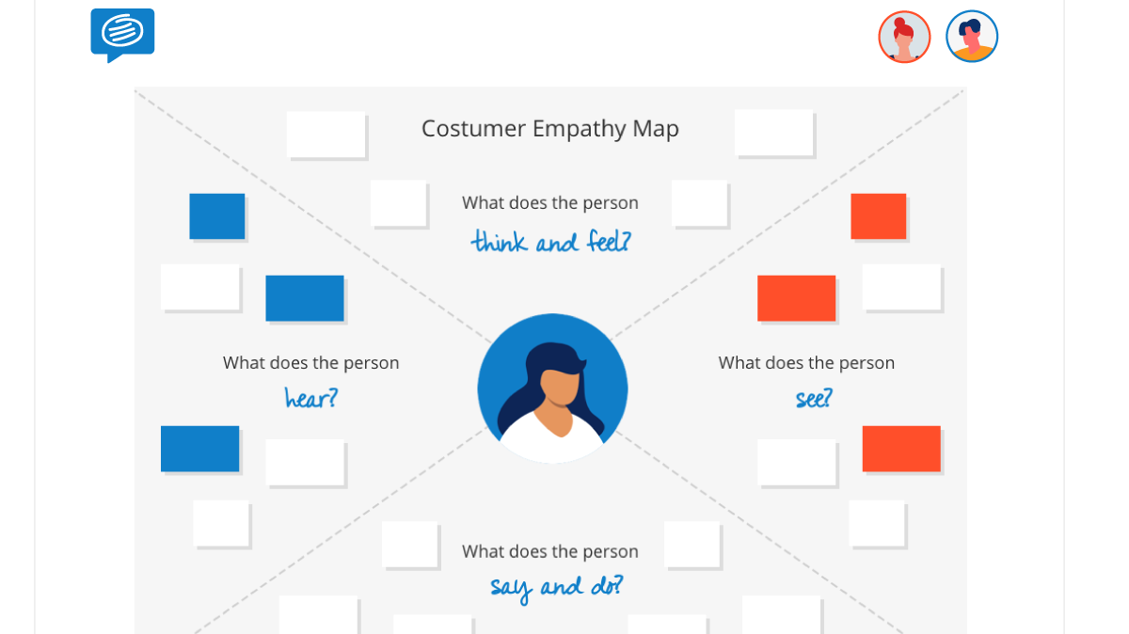
WHAT ARE PEOPLE THINKING AND FEELING?
Ask team members to capture:
Employee’s emotions and feelings.
What really matters to the employee, what are their major concerns as it relates to the subject?
WHAT ARE PEOPLE HEARING?
Ask team members to capture :
What is being said and shared about this subject?
How and from where are they hearing this information?
WHAT ARE THE PEOPLE SEEING?
Ask team members to capture :
What actions or behaviors are employees seeing as it relates to the subject?
What are they seeing happening in the external environment/ competitors?
Is what they are seeing, matching what they are hearing?
WHAT ARE PEOPLE SAYING AND DOING?
Ask team members to capture :
What are employees actually saying about the subject?
Has any action been taken about the subject
Is there a coherence between what is said and what is done.
Once complete, collate post-its with similar comments and summarize the key findings for the debrief.

Slide 12
5 WHY’s
Define—The root cause of the problem, this helps us ensure we address the problem not only the symptom

Slide 13
5 WHYS
1. Define the Problem
2. Ask the First Why
3. Ask why 4 more time
5. Know when to stop
Pick up the key findings from the empathy map
For Ex: Decisions are not getting communicated effectively.
Write the problem statement on the whiteboard/ flip chart, leaving enough space around it to add the answers to the repeated question, "Why?“
Ask your team WHY the problem is occurring.
(For example, "Why are decisions not getting communicated effectively.
Asking "Why?" sounds simple, but answering it requires serious thought. Search for answers that are grounded in fact: they must be accounts of things that have actually happened, not guesses of what might be happening. Your team members may come up with one obvious reason why, or several plausible ones. Record their answers as succinct phrases, rather than as single words or lengthy statements, and write them below (or beside) your problem statement. For example, saying “line managers do not explain rationale behind every decision " is better than a vague “managers are unclear”.
For each of the answers that you generated in Step 2, ask four further "whys" in succession.
Each time, frame the question in response to the answer you've just recorded.
You'll know that you've revealed the root cause of the problem when asking "why" produces no more useful responses, and you can go no further. If you identified more than one reason in Step 3, repeat this process for each of the different branches of your analysis until you reach a root cause for each one.

Slide 14
EXAMPLE:
PROBLEM STATEMENT: Decisions don’t get communicated effectively.
WHY?
Managers do not explain the rationale behind decisions and hence the communication suffers
WHY?
Managers do not find the time to sit with the teams to explain rationale and manage expectations around such decisions
WHY?
Managers are busy firefighting everyday issues and listening to employees tends to take a backseat
WHY?
Managers don’t have a specific time and communication channel to discuss issues like these
WHY?
No apparent reason- but can be fixed if managers can accommodate this on their weekly schedules

